Slide 1


Project name
IGATE is now a part of Capgemini

Slide 2
TEAM MEMBERS
Prasanthi Thota 150736
Repaka Srujala 150735
Kamidi Mahender 150935
B, Sabareeshwari 150737

Slide 3
CONTENTS
OVERVIEW
REQUIREMENT ITEMIZATION
USECASE
ACTORS
TEST CASE
APPLICATION LINK
TEST CASE ADEQUACY
TEST CASE EFFECTIVENESS
PROJECT STATISTICS
TRACEABALITY MATRIX

Slide 4
OVERVIEW OF THE PROJECT

Slide 5
Requirements Validation And Functional Decomposition
Termination
End process
File Handling
Storage of information
Invocation
Start process
Implicit
Efficiency
RVFD
System
Minimum specifications
Explicit
User specified
Query
improvements
Error Handling
consistency
Security
For confidentiality

Slide 6
REQUIREMENT ITEMIZATION
Requirements validation is an iterative process which takes place throughout the lifecycle of the project.
During elicitation, analysis and specification you should constantly be questioning and clarifying the data given to you in order to check its validity.
This will ensure that the SRS that you produce is complete, consistent and ready for the formal validation process.
LINK: AMS RVFD

Slide 7
USE CASES

Slide 8
ACTORS

Slide 9
USE CASES
A use case is a methodology used in system analysis to identify, clarify, and organize system requirements.
The use case is made up of a set of possible sequences of interactions between systems and users in a particular environment and related to a particular goal.
A use case can be thought of as a collection of possible scenarios related to a particular goal, indeed, the use case and goal are sometimes considered to be synonymous.

Slide 10
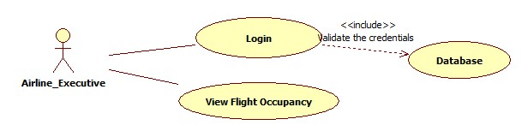
USE CASE DIAGRAM
Airline Executive

Slide 11
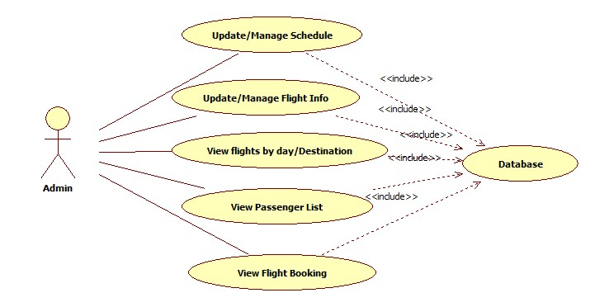
USE CASE DIAGRAM
Admin

Slide 12
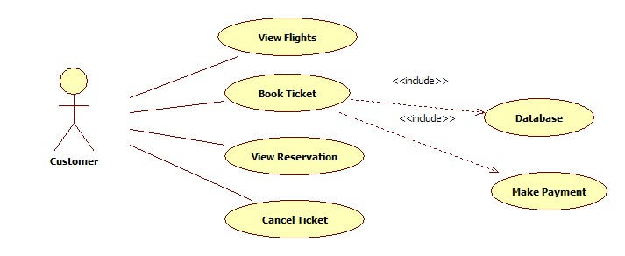
USE CASE DIAGRAM
Customer

Slide 13
TEST CASES
A test case is a set of conditions or variables under which a tester will determine whether a system under test satisfies requirements or works correctly.
The process of developing test cases can also help find problems in the requirements or design of an application.

Slide 14
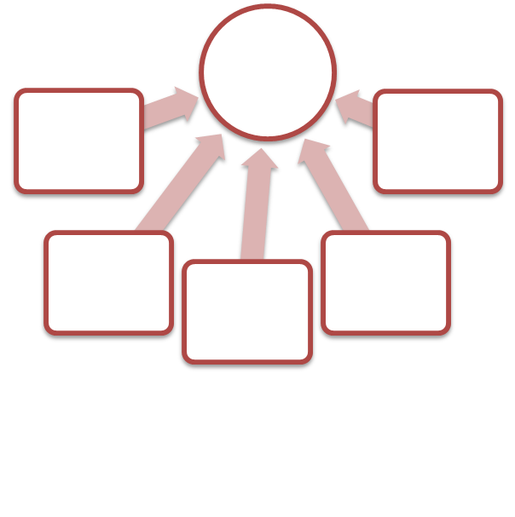
Link : AMS TEST cASE
TEST CASES
LOGIN

Slide 15

Application link
http://ndafile:8081/AssetManagementSystem_Spring/index.html

Slide 16
DFDR
A defect is an error or a bug, in the application that causes it to produce an incorrect or unexpected results.
A programmer while designing and building the software can make mistake or error.
These mistakes or errors mean that there are flaws in the software, these are called defects and the report written for logging these defects is called a defect report.
LINK: AMS Defect

Slide 17
DEFECTS FOUND
Manager
The system does not display appropriate error message on entering invalid username and invalid password
Some of the links present in all the pages is not navigating the user to proper web page
There are some common spelling mistakes in all the pages
The manager is found to raise a request even with entering invalid values in the Asset details fields
The manager is found to raise a request even with entering null values in the Asset details fields
The user is able to view status of raised request even with entering invalid Emp No

Slide 18
DEFECTS FOUND
The system does not display appropriate error message on leaving both the username and password fields as blank
The system does not display appropriate error message on entering invalid username and invalid password
Some of the links present in all the pages is not navigating the user to proper web page
There are some common spelling mistakes in all the pages
The system does not display appropriate error message on leaving asset details fields as blank
The system does not display appropriate error message on entering invalid values in asset details fields
Admin

Slide 19
Test Case Adequacy
This defines the number of actual test cases created vs estimated test cases at the end of test case preparation phase. It is calculated as
Test Case Adequacy = No. of actual Test cases*100/No. of estimated Test cases estimated
=(159*100)/200
=79.5

Slide 20
Test Case Effectiveness
This metrics defines the effectiveness of the test cases which is measured in terms of the number of defects found in testing with using the test cases.
Test Case Effectiveness = No. of defects detected using test cases*100)/total no of defects detected in testing
=(53*100)/70
=75.71

Slide 21
Project Statistics
Number of Test Cases = 159
Number of Test Cases Passed = 106
Number of Test Cases Failed = 53
Number of Defects Logged = 44
Number of Use Cases = 9

Slide 22
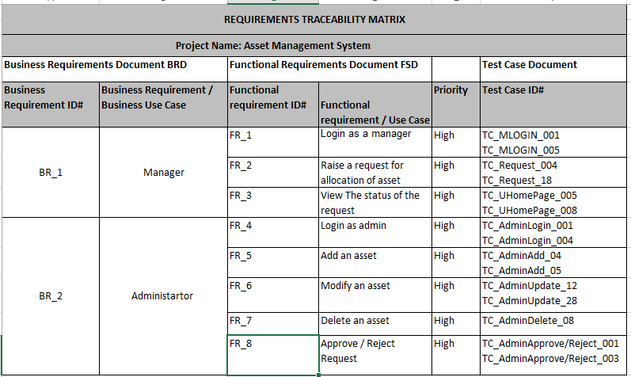
Traceability Matrix

Slide 23
THANK YOU

Slide 24
USE CASE HYPERLINKS
Login:
AMS Manager Login
AMS Admin Login
Functionalities:
AMS Manager Raise Request
AMS Manager View Request
AMS Admin Add Asset
AMS Admin Modify Asset
AMS Admin Delete Asset
AMS Admin View Asset
AMS Admin Accept/Reject Asset

